Slide 1
Inspiring metallurgy

Slide 2
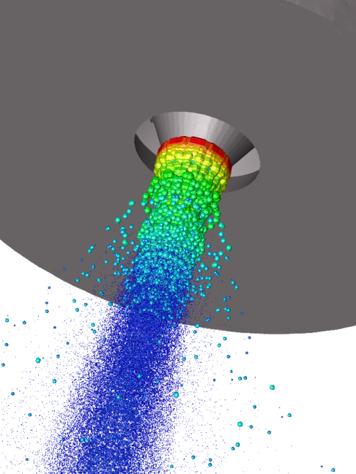
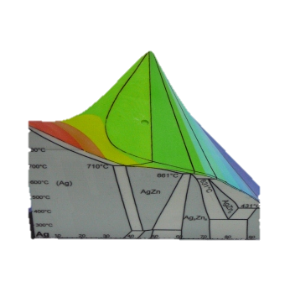
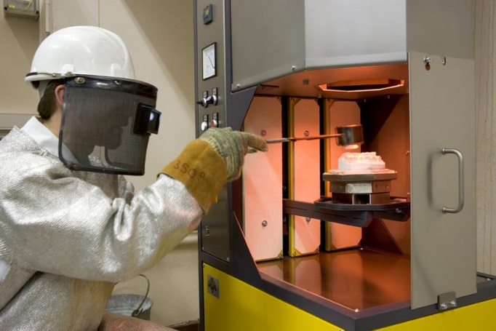
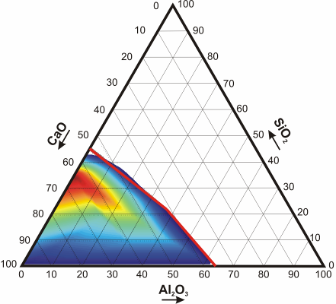
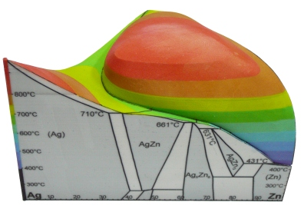
InsPyro
Consultancy company
10 years
Wide tool set
Thermodynamics & phase diagrams
Flowsheet modelling
CFD: flow and heat transfer
Experiments at high T
Characterization

Slide 3
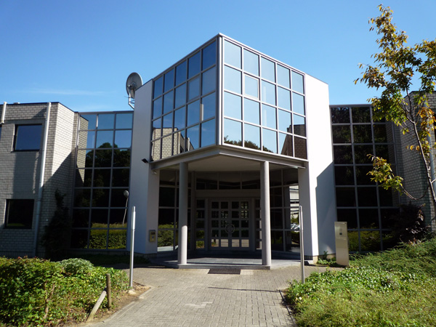
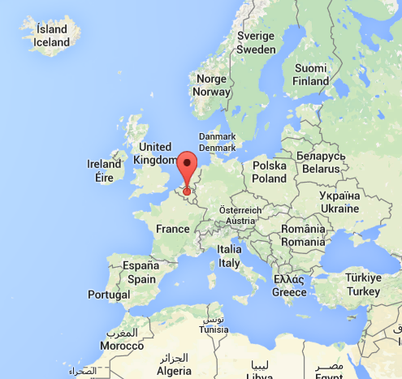
InsPyro: contact
InsPyro NV
Kapeldreef 60
3001 Leuven
Belgium
+ 32 16 298 491
info@inspyro.be
www.inspyro.be

Slide 4
Inspiring metallurgy

